Slide 1
Components of Deep Network
컴퓨터AI공학부 AI학과
2023년 2학기 머신러닝

Slide 2
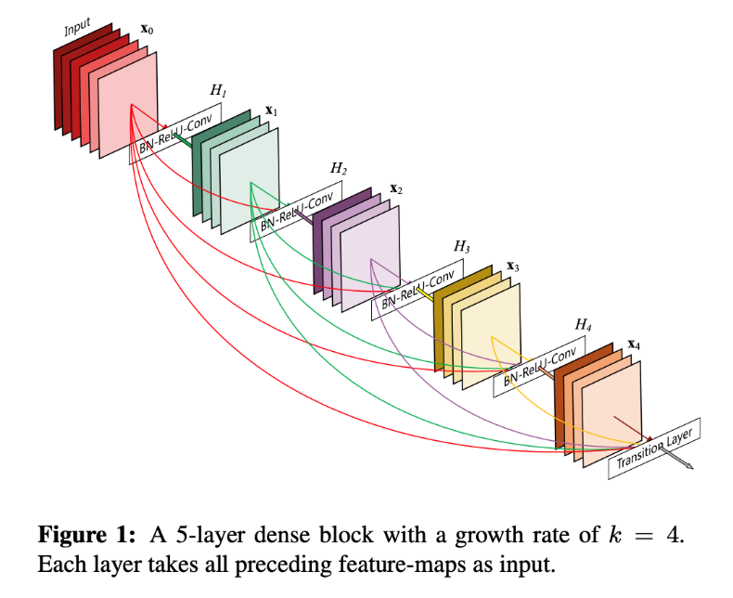
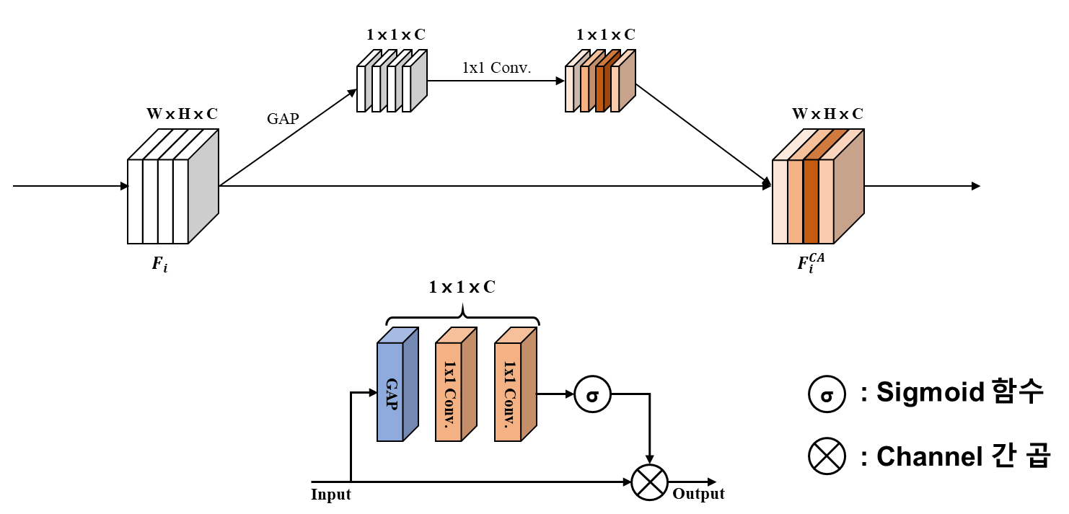
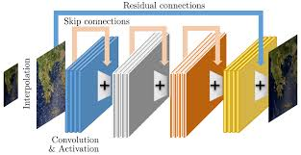
딥러닝 주요모델 구성요소
Skip connection (ResNet, 2015)
Dense connection (DenseNet, 2017)
Channel attention (SENet, 2017)
Skip connection
Dense connection
Channel attention

Slide 3
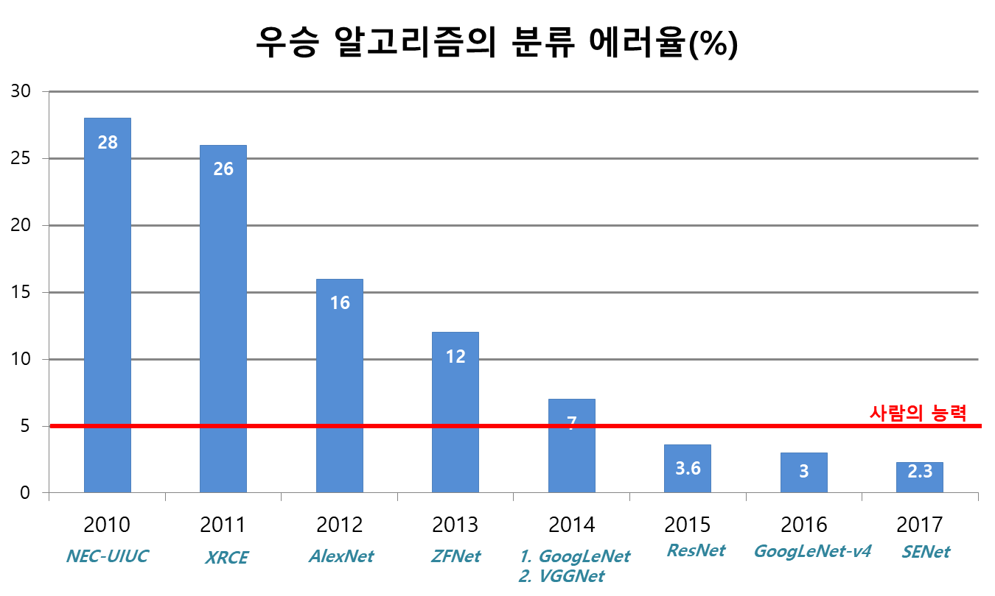

Baseline Model – VGG-16 (Visual Geometry Group)
간소화된 VGG 구조에서 딥러닝 구성요소 추가 실습 진행
3 x 3 x 3 x 64
(S1/P1)
3 x 3 x 64 x 64
(S1/P1)
2x2 Max Pooling (S2)
112 x 112 x 64
3 x 3 x 64 x 128
(S1/P1)
3 x 3 x 128 x 128
(S1/P1)
<VGG-16 구조>

Slide 4
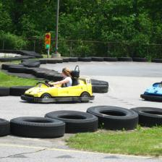
Simplified VGG Network
CIFAR-10 데이터셋 분류를 위해 네트워크 구조 변경 (32x32x3, 10 classes)
기존 VGG16을 CNN layer를 6개로 간소화
: Convolution layer
: Activation function
: Pooling layer
: Fully connected layer
[3x3x3]x16, s1, p1
ReLU
[3x3x16]x32, s1, p1
ReLU
MaxPool
[3x3x32]x32, s1, p1
ReLU
[3x3x32]x64, s1, p1
ReLU
MaxPool
[3x3x64]x128, s1, p1
ReLU
[3x3x128]x256, s1, p1
ReLU
MaxPool
평탄화
4096x512
ReLU
512x256
ReLU
256x10
32x32x3
예측결과
10x1

Slide 5
Wrap-up
torch.nn.Conv2d() 함수를 이용한 합성곱 계층 구현
6
[5x5x6]x16, s1, p0
16
Convolutional layer
[KW x KH x C] x N, stride, padding
Input feature map
Output feature map
self.conv = nn.Conv2d (in_channels = 6, out_channels = 16, kernel_size = 5, stride = 1, padding = 0)
Ref.: https://pytorch.org/docs/stable/generated/torch.nn.Conv2d.html?highlight=conv2d#torch.nn.Conv2d

Slide 6
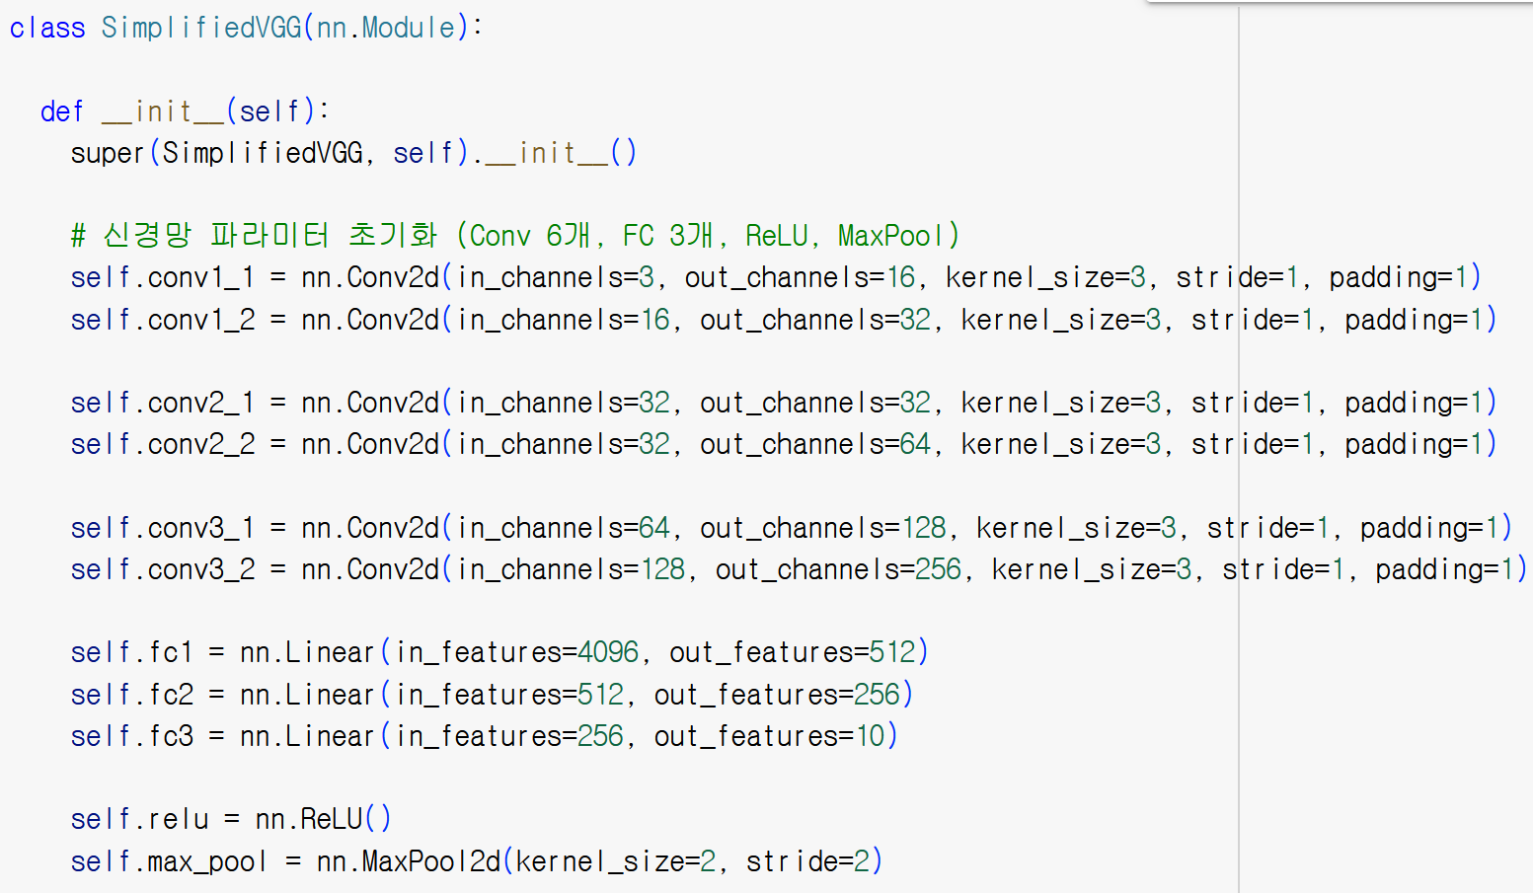
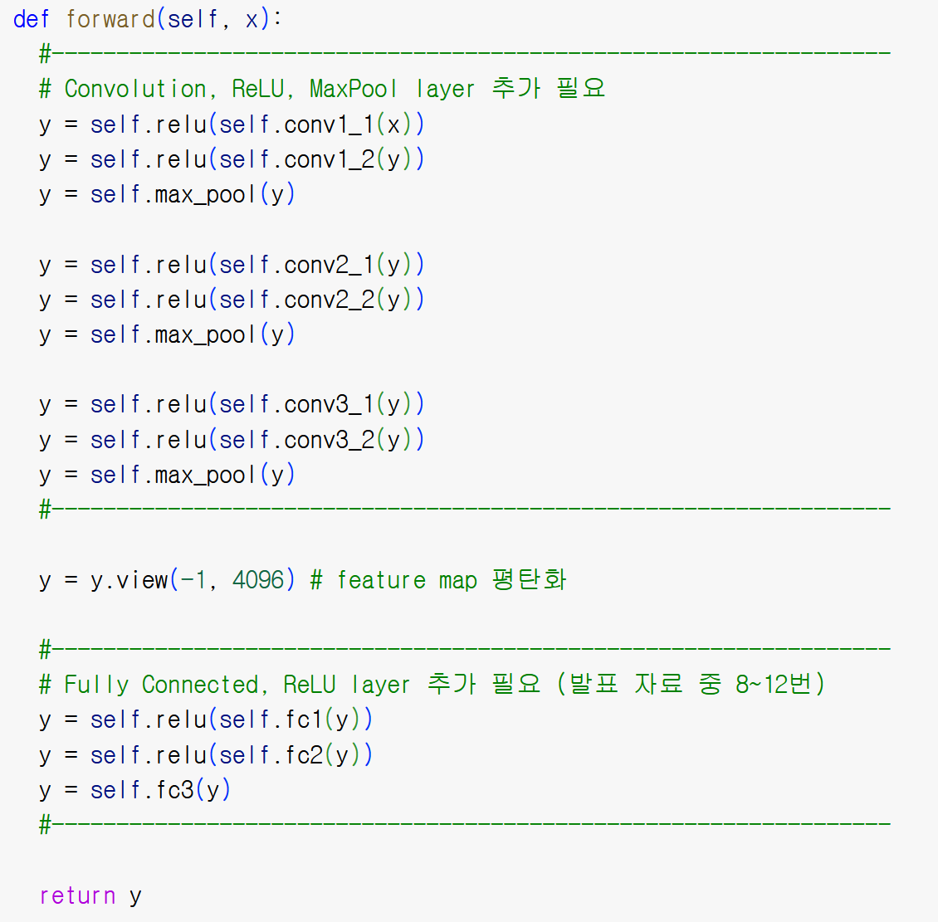
Simplified VGG Network
VGG 간소화 모델 코드 공유
LMS 11주차 base code 다운로드
실습 시 Model 구조 선언 부분만 수정

Slide 7
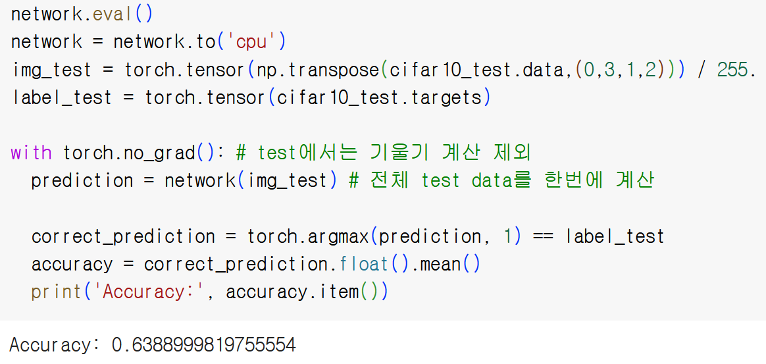
CIFAR10 분류 실습 - CNN을 이용한 분류(VGGNet)
CIFAR-10 데이터셋 분류를 위해 네트워크 구조 변경 (32x32x3, 10 classes)
: Convolution layer
: Activation function
: Pooling layer
: Fully connected layer
32x32x3
[3x3x3]x16
ReLU
[3x3x16]x32
ReLU
MaxPool
[3x3x32]x32
ReLU
[3x3x32]x64
ReLU
MaxPool
[3x3x64]x128
ReLU
[3x3x128]x256
ReLU
MaxPool
평탄화
4096x512
ReLU
512x256
ReLU
256x10
예측결과
10x1
실습 Network base 구조 (Stride와 Padding size는 1로 고정)
하이퍼 파라미터
Training epoch: 20
Batch size: 100
Learning rate: 0.1
Loss function: Cross Entropy Loss
Optimizer: SGD

Slide 8
딥러닝 주요모델 구성요소
Skip connection (ResNet, 2015)
Dense connection (DenseNet, 2017)
Channel attention (SENet, 2018)
Skip connection
Dense connection
Channel attention

Slide 9
Simplified VGG Network + Skip Connections
Skip connection 추가 실험
: Convolution layer
: Activation function
: Pooling layer
: Fully connected layer
32x32x3
[3x3x3]x16
ReLU
[3x3x16]x32
ReLU
MaxPool
[3x3x32]x32
ReLU
[3x3x32]x64
ReLU
MaxPool
[3x3x64]x128
ReLU
[3x3x128]x256
ReLU
MaxPool
평탄화
4096x512
ReLU
512x256
ReLU
256x10
+
+
+
[3x3x3]x32
[3x3x32]x64
[3x3x64]x256
32x32x3
32x32x32
16x16x32
16x16x64
8x8x64
8x8x256
주의사항: Skip connection은 Width, Height, Channel이 모두 같아야 사용 가능

Slide 10
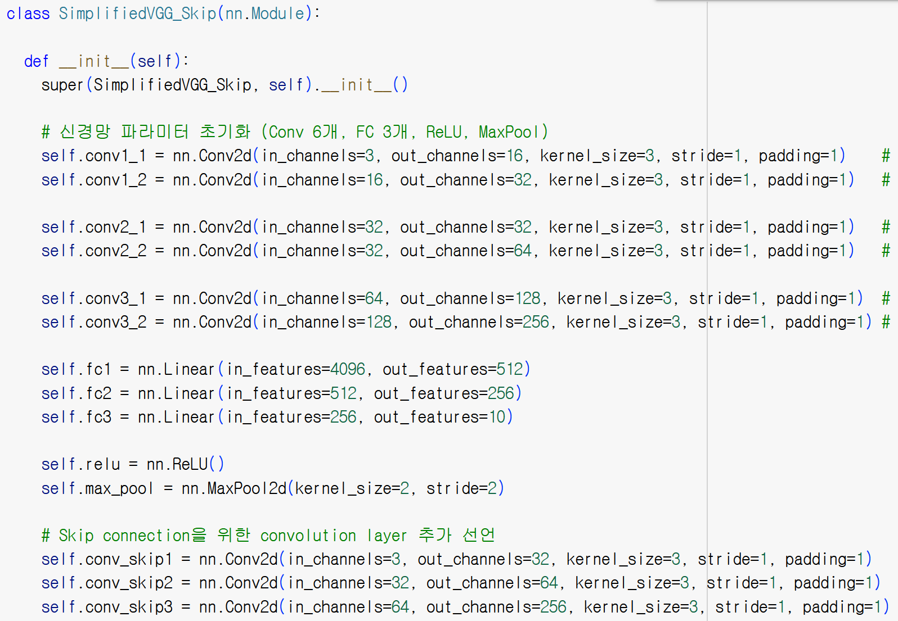
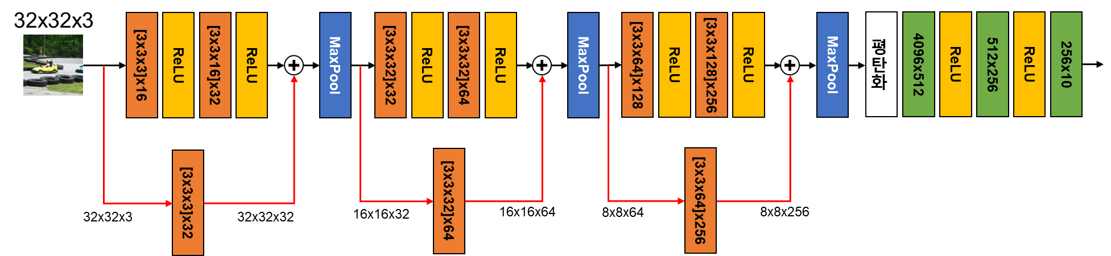
Simplified VGG Network + Skip Connections
Skip connection 추가 실험
Skip connection을 위한 convolution layer 선언
convolutional layer
추가 선언

Slide 11
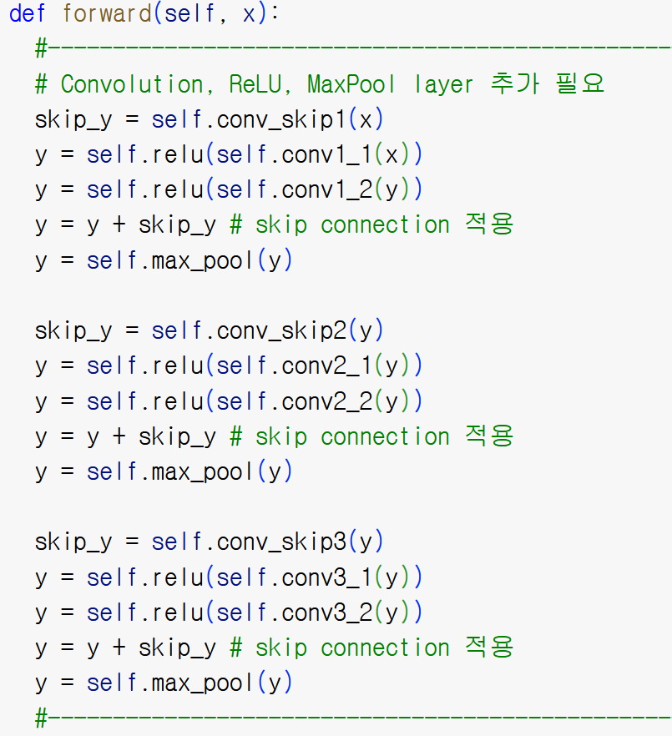
Simplified VGG Network + Skip Connections
Skip connection 추가 실험
Skip connection 적용

Slide 12
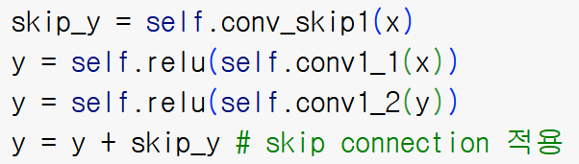
Simplified VGG Network + Skip Connections
Skip connection 추가 실험
y
Skip connection에 사용할 feature map (skip_y) 저장
x
x
skip_y

Slide 13
Simplified VGG Network + Skip Connections
Skip connection 추가 실험
y
Convolution 연산을 통해 feature map (y) 생성
x
x
skip_y

Slide 14
Simplified VGG Network + Skip Connections
Skip connection 추가 실험
y
x
Skip connection 적용
x
skip_y

Slide 15
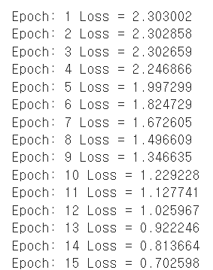
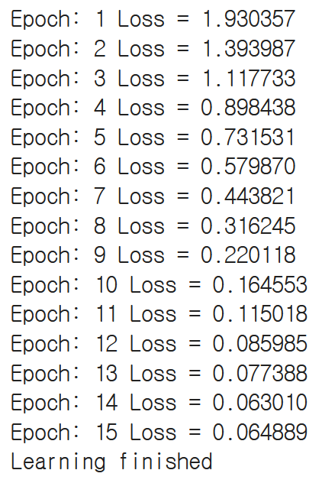
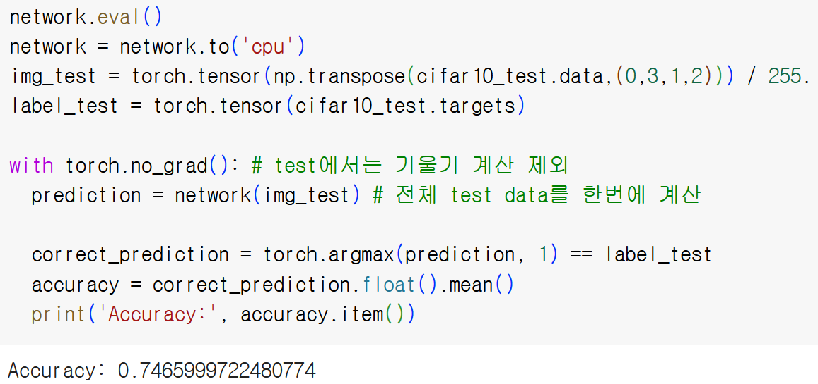
Simplified VGG Network + Skip Connections
Skip connection 추가 실험 결과 확인
Training 결과
Test 결과

Slide 16
딥러닝 주요모델 구성요소
Skip connection (ResNet, 2015)
Dense connection (DenseNet, 2017)
Channel attention (SENet, 2018)
Skip connection
Dense connection
Channel attention

Slide 17
Simplified VGG Network + Dense Connections
Dense connection 추가 실험
: Convolution layer
: Activation function
: Pooling layer
: Fully connected layer
32x32x3
[3x3x3]x16
ReLU
[3x3x16]x32
ReLU
MaxPool
[3x3x35]x32
ReLU
[3x3x32]x64
ReLU
MaxPool
[3x3x99]x128
ReLU
[3x3x128]x256
ReLU
MaxPool
평탄화
4096x512
ReLU
512x256
ReLU
256x10
C
C
32x32x3
16x16x35
Concat. 이후 출력크기
32x32x35
Concat. 이후 출력크기
16x16x99
주의사항: Dense connection (torch.cat)은 width, height이 동일해야 적용 가능

Slide 18
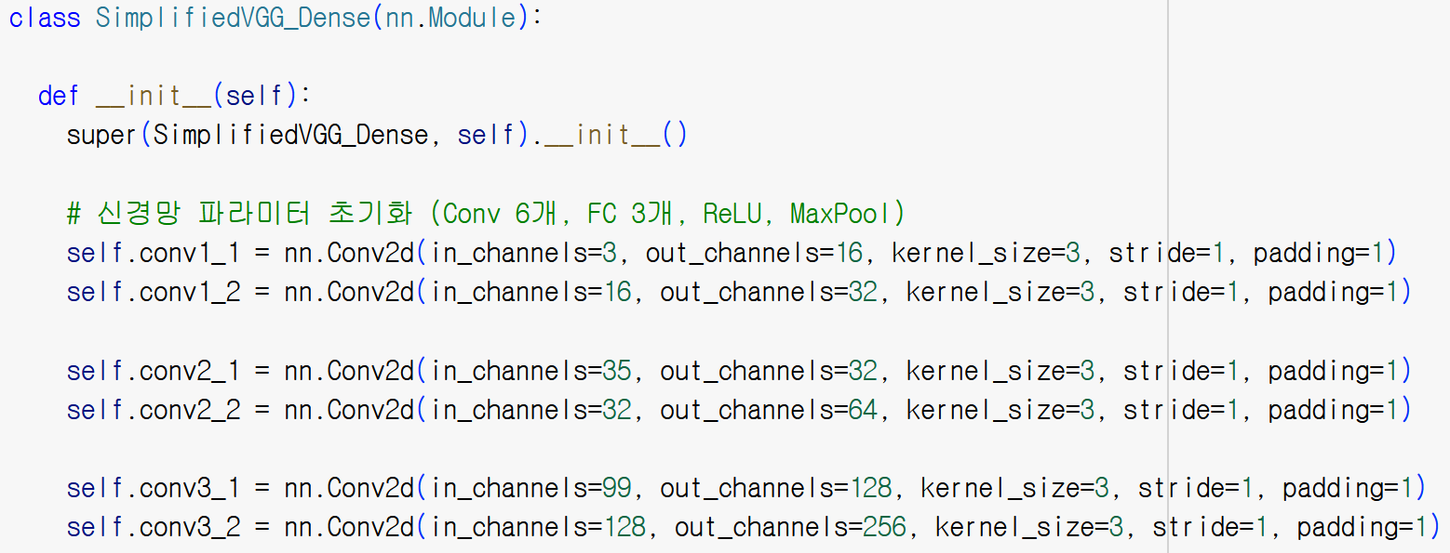
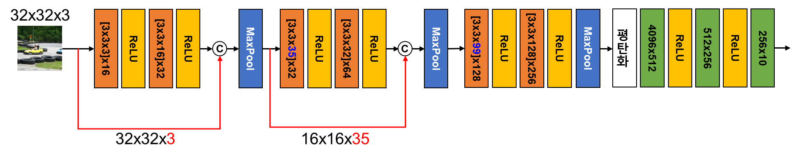
Simplified VGG Network + Dense Connections
Dense connection 추가 실험
Feature map channel 증가로 인한 convolution layer의 Input channels 변경

Slide 19
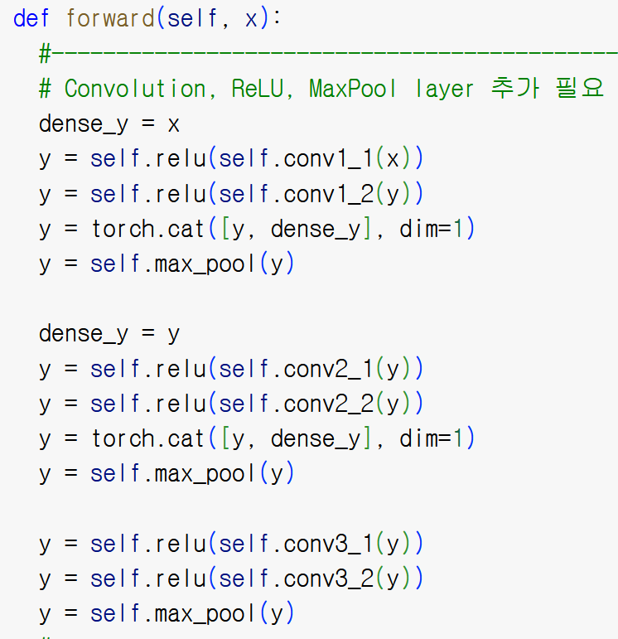
Simplified VGG Network + Dense Connections
Dense connection 추가 실험
Dense connection 코드 추가: torch.cat([feat1, feat2, …], dim=1)
out1 = torch.cat([feat1, feat2, …], dim=1)
Feature map 형상: (Batch_size, Channel, Width, Height)
dim: 0 1 2 3

Slide 20
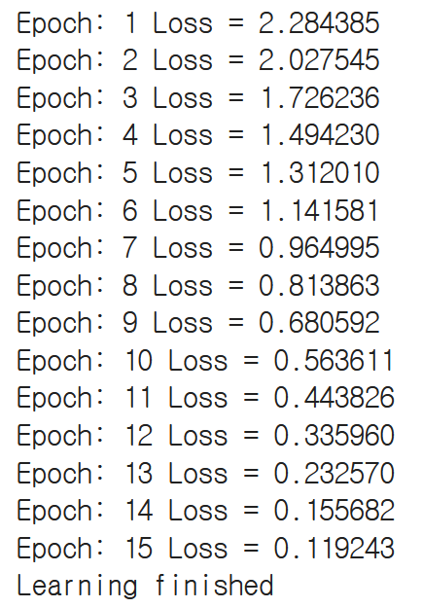
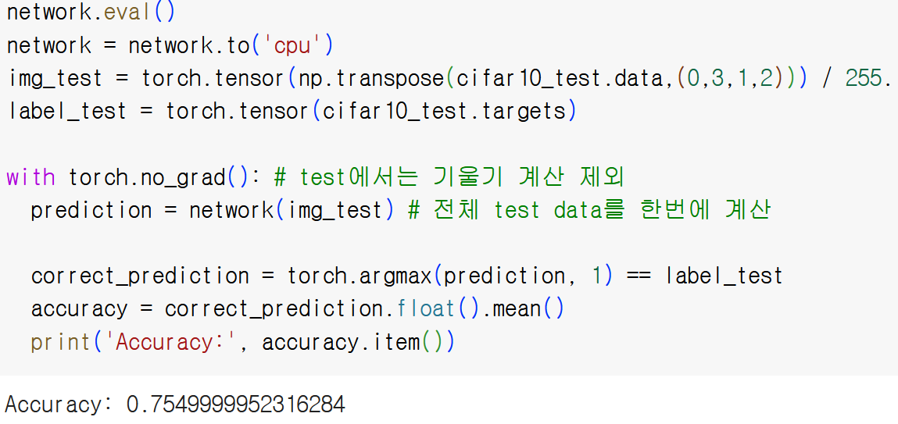
Simplified VGG Network + Dense Connections
Dense connection 추가 실험 결과 확인
Training 결과
Test 결과

Slide 21
딥러닝 주요모델 구성요소
Skip connection (ResNet, 2015)
Dense connection (DenseNet, 2017)
Channel attention (SENet, 2018)
Skip connection
Dense connection
Channel attention

Slide 22
Simplified VGG Network + Channel Attention
Channel attention (CA) 추가 실험
: Convolution layer
: Activation function
: Pooling layer
: Fully connected layer
32x32x3
[3x3x3]x16
ReLU
[3x3x16]x32
ReLU
MaxPool
[3x3x32]x32
ReLU
[3x3x32]x64
ReLU
CA
MaxPool
[3x3x64]x128
ReLU
[3x3x128]x256
ReLU
MaxPool
평탄화
4096x512
ReLU
512x256
ReLU
256x10
GAP
[1x1x64]x64
ReLU
[1x1x64]x64
σ
: Sigmoid 함수
σ
: Channel 간 곱
Input
Output
GAP: Global Average Pooling

Slide 23
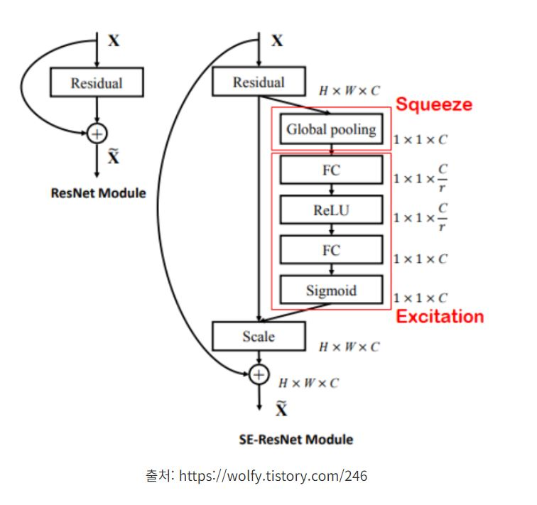
Simplified VGG Network + Channel Attention
Channel attention (CA) 추가 실험
Channel attention block 선언
GAP
[1x1xC]xC/r
ReLU
[1x1xC/r]xC
σ
σ
: Sigmoid 함수
: Channel 간 곱
Input
Output
: Convolution layer
: Activation function
: Pooling layer

Slide 24
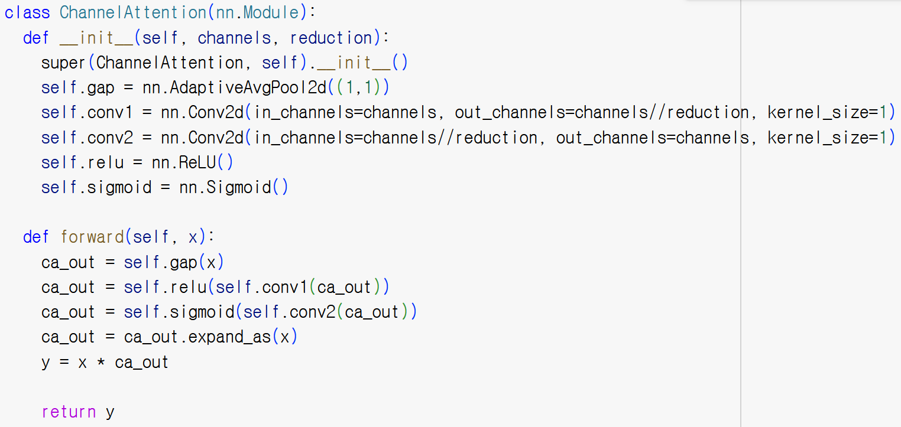
Simplified VGG Network + Channel Attention
Channel attention (CA) 추가 실험
Channel attention block 선언

Slide 25
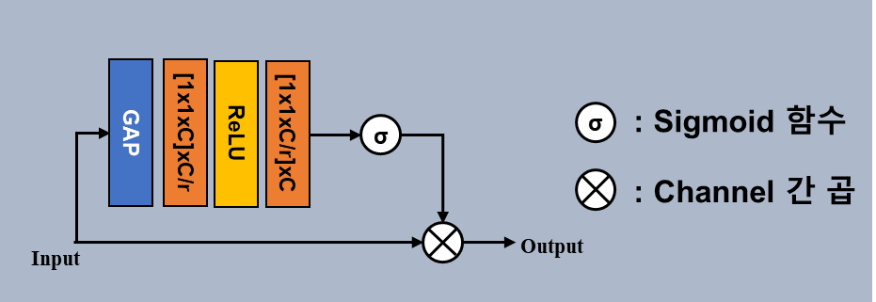
Simplified VGG Network + Channel Attention
Channel attention (CA) 추가 실험
Channel attention block 선언
GAP
4x4x4
1x1x4

Slide 26
Simplified VGG Network + Channel Attention
Channel attention (CA) 추가 실험
Channel attention block 선언
Conv1&
ReLU
(reduction: 2)
1x1x4
1x1x2

Slide 27
Simplified VGG Network + Channel Attention
Channel attention (CA) 추가 실험
Channel attention block 선언
Conv2&
Sigmoid
(reduction: 2)
1x1x2
1x1x4
Channel 별 중요도 (weights)

Slide 28
Simplified VGG Network + Channel Attention
Channel attention (CA) 추가 실험
Channel attention block 선언
expand
1x1x4
4x4x4

Slide 29
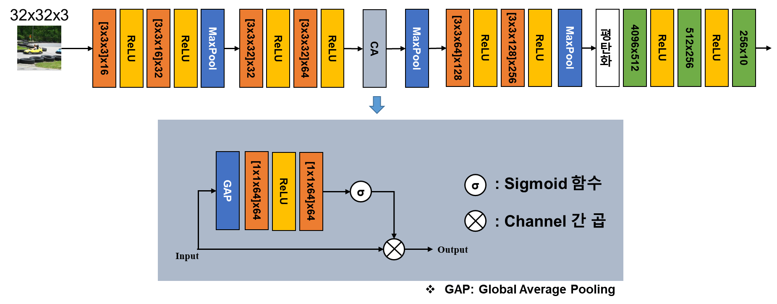
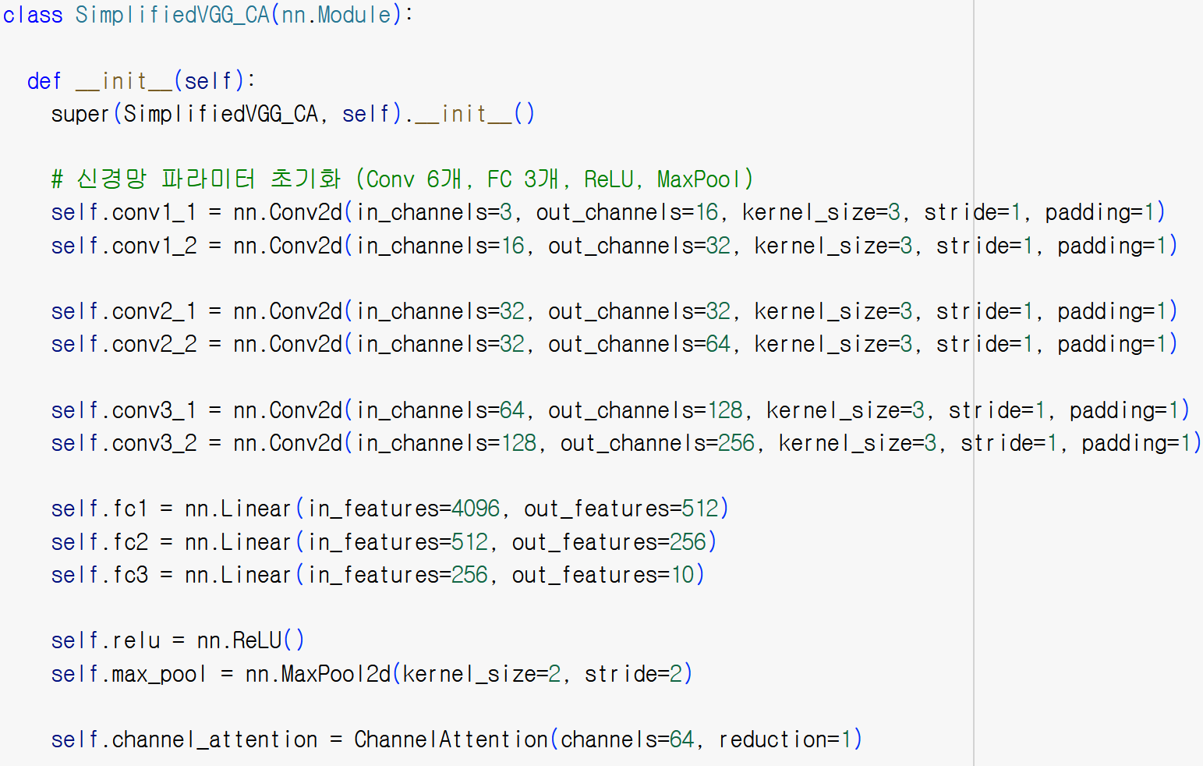
Simplified VGG Network + Channel Attention
Channel attention (CA) 추가 실험
VGG 구조 중 channel attention 선언

Slide 30
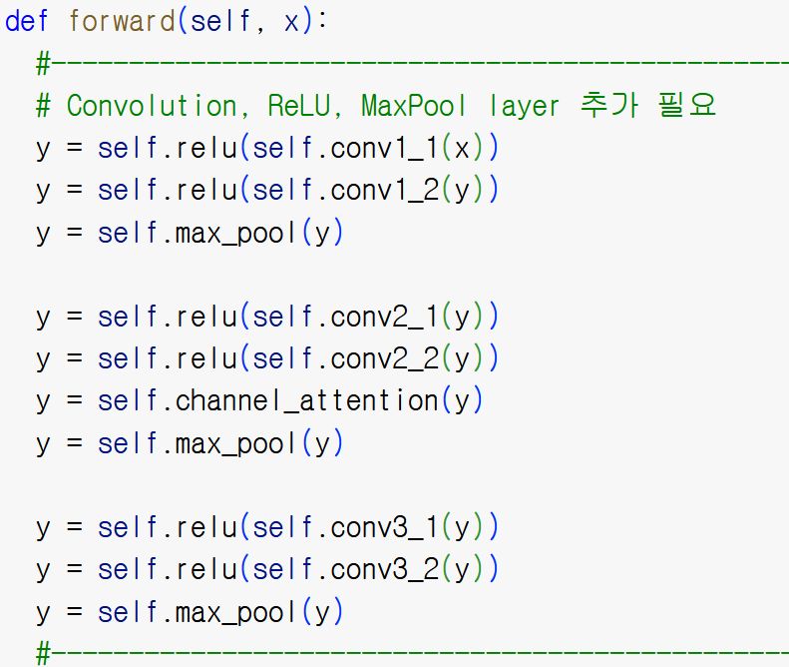
Simplified VGG Network + Channel Attention
Channel attention (CA) 추가 실험
VGG 구조 중 channel attention 선언

Slide 31
Appendix – CNN 구성요소 조합 실험
조합 실험: Skip, Dense Connection, Channel Attention
: Convolution layer
: Activation function
: Max Pooling layer
: Fully connected layer
32x32x3
[3x3x3]x16
ReLU
[3x3x16]x32
ReLU
MaxPool
[3x3x35]x32
ReLU
[3x3x32]x64
ReLU
Channel Atten.
MaxPool
[3x3x99]x128
ReLU
[3x3x128]x256
ReLU
MaxPool
평탄화
4096x512
ReLU
512x256
ReLU
256x10
+
C
+
C
+
[3x3x3]x32
[3x3x35]x64
[3x3x99]x256
Skip connection
Skip connection
Skip connection
Dense connection
Dense connection
주의사항(1): Skip connection은 Width, Height, Channel이 모두 같아야 사용 가능
주의사항(2): Dense connection (torch.cat)은 width, height이 동일해야 적용 가능

Slide 32
Dongsan Jun (dsjun@dau.ac.kr)
Image Signal Processing Laboratory (www.donga-ispl.kr)
Dept. of Computer Engineering
Dong-A University, Busan, Rep. of Korea

